Slide 1
Process Concept
Process – a program in execution; process execution must progress in sequential fashion
Multiple parts
The program code, also called text section
Current activity including program counter, processor registers
Stack containing temporary data
Function parameters, return addresses, local variables
Data section containing global variables
Heap containing memory dynamically allocated during run time

Slide 2
Process Concept (Cont.)
Program is passive entity stored on disk (executable file), process is active
Program becomes process when executable file loaded into memory
Execution of program started via GUI mouse clicks, command line entry of its name, etc
One program can be several processes
Consider multiple users executing the same program

Slide 3
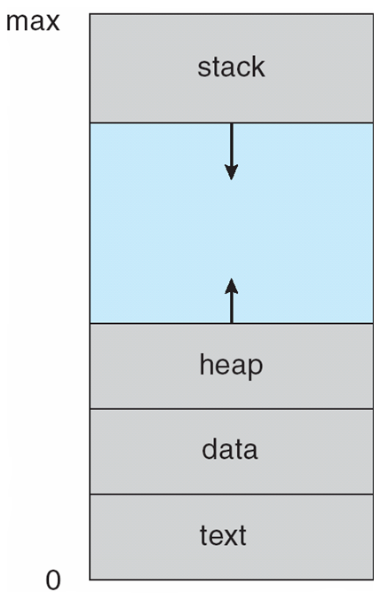
Process in Memory

Slide 4
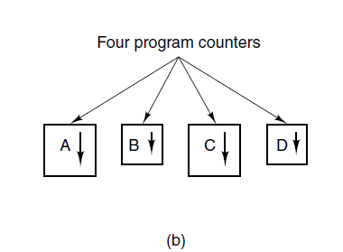
The Process Model (2)
Figure 2-1. (b) Conceptual model of
four independent, sequential processes.

Slide 5
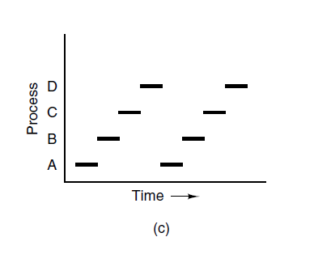
The Process Model (3)
Figure 2-1. (c) Only one program is active at once.

Slide 6
2.1.2 Process Creation
Principal events that cause processes to be created:
System initialization.
Execution of a process creation system call by a running process.
A user request to create a new process.

Slide 7
2.1.3 Process Termination
Typical conditions which terminate a process:
Normal exit (voluntary).
Error exit (voluntary).
Fatal error (involuntary).
Killed by another process (involuntary).

Slide 8
2.1.4 Process Hierarchies
Processes can create other processes, forming a hierarchy
A process with its descendants form a process group
A special process, init (pid 1), is started when a UNIX system boots, and is the root ancestor of all running processes (a single tree)

Slide 9
2.1.5 Process States (1)
Three states a process may be in:
Running (actually using the CPU at that instant).
Ready (runnable; temporarily stopped to let another process run).
Blocked (unable to run until some external event happens).

Slide 10
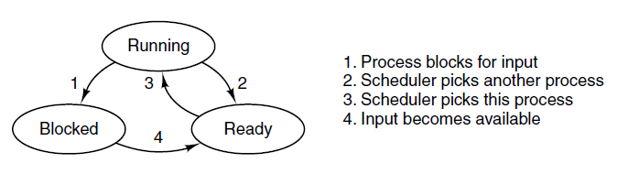
Process States (2)
Figure 2-2. A process can be in running, blocked, or ready state. Transitions between these states are as shown.

Slide 11
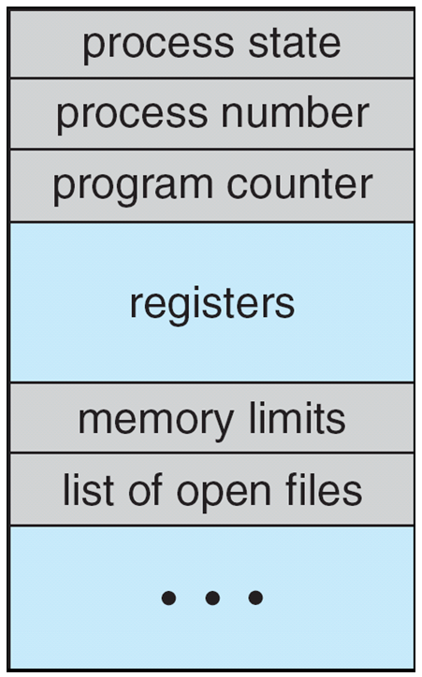
Process Control Block (PCB)
Information associated with each process
(also called task control block)
Process state – running, waiting, etc
Program counter – location of instruction to next execute
CPU registers – contents of all process-centric registers
CPU scheduling information- priorities, scheduling queue pointers
Memory-management information – memory allocated to the process
Accounting information – CPU used, clock time elapsed since start, time limits
I/O status information – I/O devices allocated to process, list of open files

Slide 12
Context Switch
When CPU switches to another process, the system must save the state of the old process and load the saved state for the new process via a context switch
Context of a process represented in the PCB
Context-switch time is overhead; the system does no useful work while switching
The more complex the OS and the PCB ➔ the longer the context switch
Time dependent on hardware support
Some hardware provides multiple sets of registers per CPU ➔ multiple contexts loaded at once

Slide 13
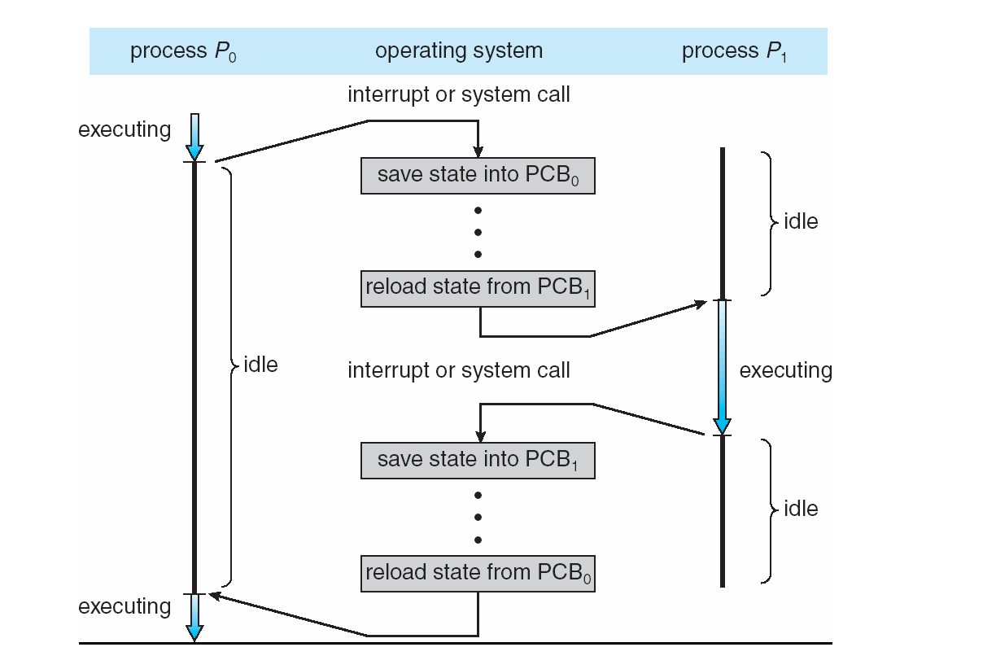
CPU Switch From Process to Process

Slide 14
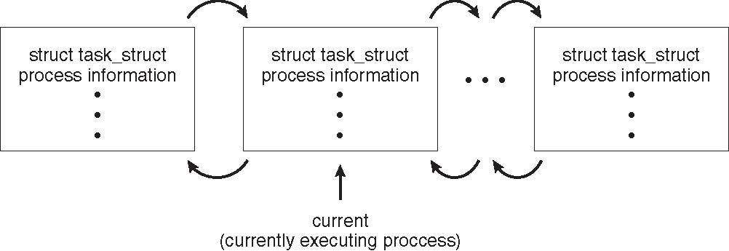
Process Representation in Linux
Represented by the C structure task_struct
pid t_pid; /* process identifier */ long state; /* state of the process */ unsigned int time_slice; /* scheduling information */ struct task_struct *parent; /* this process’s parent */ struct list_head children; /* this process’s children */ struct files_struct *files; /* list of open files */ struct mm_struct *mm; /* address space of this process */

Slide 15
Process Scheduling
Maximize CPU use, quickly switch processes onto CPU for time sharing
Process scheduler selects among available processes for next execution on CPU
Maintains scheduling queues of processes
Job queue – set of all processes in the system
Ready queue – set of all processes residing in main memory, ready and waiting to execute
Device queues – set of processes waiting for an I/O device
Processes migrate among the various queues

Slide 16
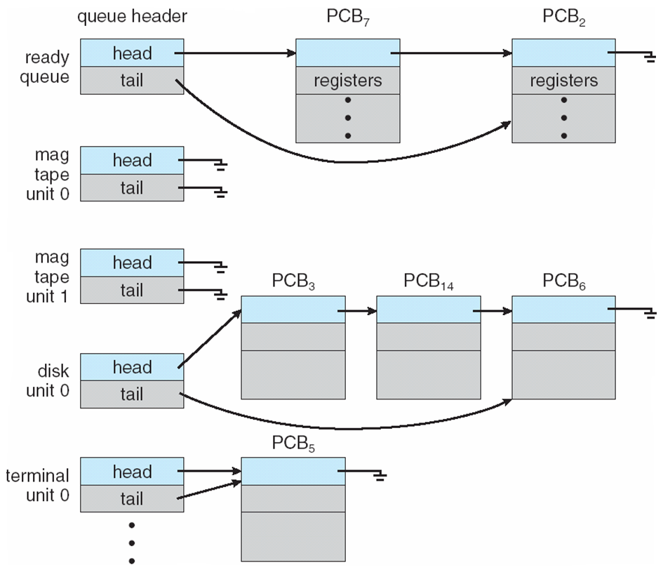
Ready Queue And Various I/O Device Queues

Slide 17
Process Creation
Parent process create children processes, which, in turn create other processes, forming a tree of processes
Generally, process identified and managed via a process identifier (pid)
Resource sharing options
Parent and children share all resources
Children share subset of parent’s resources
Parent and child share no resources
Execution options
Parent and children execute concurrently
Parent waits until children terminate

Slide 18
A Tree of Processes in Linux

Slide 19
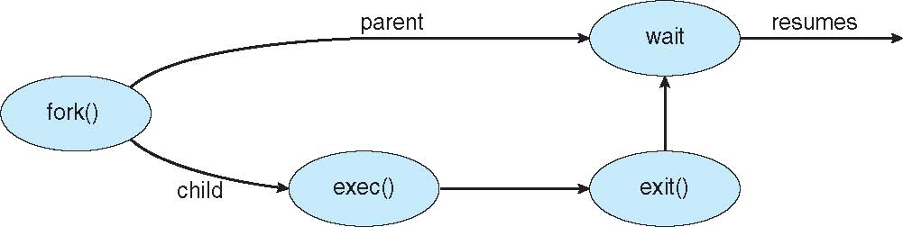
Process Creation (Cont.)
Address space
Child duplicate of parent
Child has a program loaded into it
UNIX examples
fork() system call creates new process
exec() system call used after a fork() to replace the process’ memory space with a new program

Slide 20
Process Termination
Process executes last statement and then asks the operating system to delete it using the exit() system call.
Returns status data from child to parent (via wait())
Process’ resources are deallocated by operating system
Parent may terminate the execution of children processes using the abort() system call. Some reasons for doing so:
Child has exceeded allocated resources
Task assigned to child is no longer required
The parent is exiting and the operating systems does not allow a child to continue if its parent terminates

Slide 21
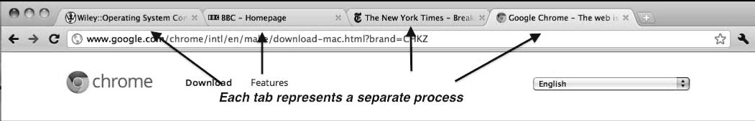
Multiprocess Architecture – Chrome Browser
Many web browsers ran as single process (some still do)
If one web site causes trouble, entire browser can hang or crash
Google Chrome Browser is multiprocess with 3 different types of processes:
Browser process manages user interface, disk and network I/O
Renderer process renders web pages, deals with HTML, Javascript. A new renderer created for each website opened
Runs in sandbox restricting disk and network I/O, minimizing effect of security exploits
Plug-in process for each type of plug-in

Slide 22
fork()
#include <unistd.h>
pid_t fork(void);
fork() creates a new process by duplicating the calling process. The new process, referred to as the child, is an exact duplicate of the calling process, referred to as the parent, except for the following points:
The child has its own unique process ID, and this PID does not match the ID of any existing process group.
The child's parent process ID is the same as the parent's process ID.
The child inherits copies of the parent's set of open file descriptors. Each file descriptor in the child refers to the same open file description as the corresponding file descriptor in the parent.
Under Linux, fork() is implemented using copy-on-write pages, so the only penalty that it incurs is the time and memory required to duplicate the parent's page tables, and to create a unique task structure for the child.

Slide 23
execve() and family
#include <unistd.h>
int execve(const char *filename, char *const argv[],
char *const envp[]);
execve() executes the program pointed to by filename; filename must be either a binary executable, or a script starting with a line of the form:
#! interpreter [optional-arg]
argv is an array of argument strings passed to the new program. By convention, the first of these strings should contain the filename associated with the file being executed. envp is an array of strings, conventionally of the form key=value, which are passed as environment to the new program. Both argv and envp must be terminated by a NULL pointer. The argument vector and environment can be accessed by the called program's main function, when it is defined as:
int main(int argc, char *argv[], char *envp[])
execve() does not return on success, and the text, data, bss, and stack of the calling process are overwritten by that of the program loaded.

Slide 24
wait() and family
#include <sys/types.h>
#include <sys/wait.h>
pid_t wait(int *status);
pid_t waitpid(pid_t pid, int *status, int options);
int waitid(idtype_t idtype, id_t id, siginfo_t *infop, int options);
All of these system calls are used to wait for state changes in a child of the calling process, and obtain information about the child whose state has changed. A state change is considered to be: the child terminated; the child was stopped by a signal; or the child was resumed by a signal. In the case of a terminated child, performing a wait allows the system to release the resources associated with the child; if a wait is not performed, then the terminated child remains in a "zombie" state: a child that terminates, but has not been waited for becomes a "zombie". If a parent process terminates, then its "zombie" children (if any) are adopted by init, which automatically performs a wait to remove the zombies.

Slide 25
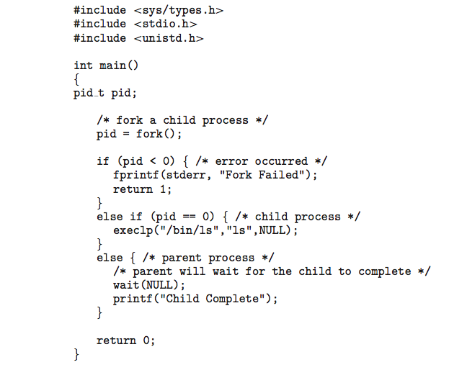
C Program Forking Separate Process

